Slide 1
Introduction To Computer Networks

Slide 2
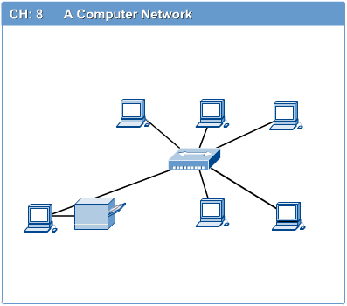
Computer Networks
Introduction to Computer Networks
Computer network is a connection of two or more computers to enable them communicate or share resources or information.
The computers can be geographically located anywhere.

Slide 3
Types of Computer Networks
Computer Networks
LAN (Local Area Network)
WAN (Wide Area Network)
MAN (Metropolitan Area Network)
PAN (Personal Area Network)

Slide 4
LAN (Local Area Network)
Introduction to Computer Networks
A network that connects computers in a relatively small geographical area for example in an office or a building, within an institution e.g UCU, URA etc.

Slide 5
Characteristics
Introduction to Computer Networks
It usually covers less than a kilometre in radius.
It is owned by the company that owns the equipment.
It is always expensive to set up and maintain for the company.

Slide 6
WAN (Wide Area Network)
Introduction to Computer Networks
A WAN : A network that connects two or more computers over a potentially large geographic distance.
Allows you to connect to other computers over a wider area i.e. a continent and even the whole world. When it covers the whole world it becomes INTERNET.

Slide 7
Characteristics
Introduction to Computer Networks
Usually consists of several interconnected switching points
Its Coverage is not limited.
It is not owned by a single company or agency but managed and financed through a cooperate effort of businesses and governments eg MTN, Airtel etc…

Slide 8
MAN (Metroplitan Area Network)
Introduction to Computer Networks
This is a type of network that basically covers a city or a region.
This normally covers a city

Slide 9
PAN (Personal Area Network)
Introduction to Computer Networks
Personal Area network This is mostly in homes.
For example your laptop to your desktop

Slide 10
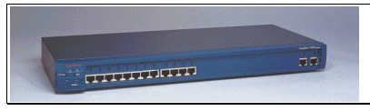
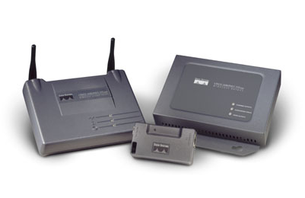
Networking Devices
Introduction to Computer Networks
HUB, Switches, Routers, Wireless Access Points, Modems etc.
Find out all the devices used in network and briefly explain what they do.

Slide 11
Advantages of Networks
Introduction to Computer Networks
Resource Sharing
Hardware (computing resources, disks, printers)
Software (application software)
Information Sharing
Easy accessibility from anywhere (files, databases)
Search Capability (WWW)
Communication
Email
Message broadcast
Remote computing
Administration and monitoring of systems

Slide 12
Advantages of Networks
Introduction to Computer Networks
Education
Backing up information
Group work made easy
Remote computing
Information access

Slide 13
Disadvantages of Networks
Introduction to the Internet
Possibility of hacking information
Easy spread of viruses and Malware
If even one computer on a network gets affected by a virus, there is a possible threat for the other systems getting affected too
Loss of information
If a server computer breaks down whole system is down
Privacy is compromised

Slide 14

Applications
Introduction to Computer Networks
E-mail
Searchable Data (Web Sites)
E-Commerce
News Groups
Internet Telephony (VoIP)
Video Conferencing
Chat Groups
Instant Messengers
Internet Radio

Slide 15
Transmission of data/information
Introduction to the Internet
How is Data/Information Transmitted?
For any data to move from one place to another there must be a transmission system.
Any Transmission system can be represented by the following Transmission Model

Slide 16
Data Transmission Model
Introduction to the Internet
Transmission system/Model (Information Systems)
It is composed of :Input, Transmitter, Transmission Channel, Receiver, Output
Input
Eg sound
Transmitter
Eg Microphone
(Encodes)
Transmission channel
Eg wire, air
Receiver
Eg speaker
(decodes)
Output
Eg sound,text

Slide 17
Internet and the WWW
Introduction to the Internet
Internet is the world network of computers
WWW- World Wide Web is a way through which information can be accessed via the internet. This information is finally displayed using a browser by using URL. It is build on top of internet.
URL: Uniform Resource Locator. Address of web page or a website. Example: http://ucu.ac.ug/

Slide 18
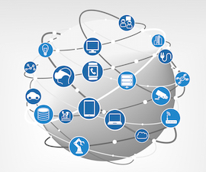

Internet and the WWW
Introduction to the Internet

Slide 19
Internet and the WWW
Introduction to the Internet
A hyperlink is simply text or an image which helps you jump to another location within the same document or to another document when clicked on. This second document may be located on the same computer as the first or on a different computer elsewhere on the Internet.

Slide 20
Internet and the WWW
Introduction to the Internet
Web Browser – Soft Ware used to request and receive web pagers from the server
Web Server- Soft Ware that processes requests from the web browser
Website – A collection of inter-related web pages
Webpage – An electronic page on a web
Search Engines - A Web search engine is a tool/SW designed to search for information on the World Wide Web while Web Browser is Soft Ware used to visit web pages
Examples of Web browsers google chrome, Internet explore, Mozilla Firefox.

Slide 21
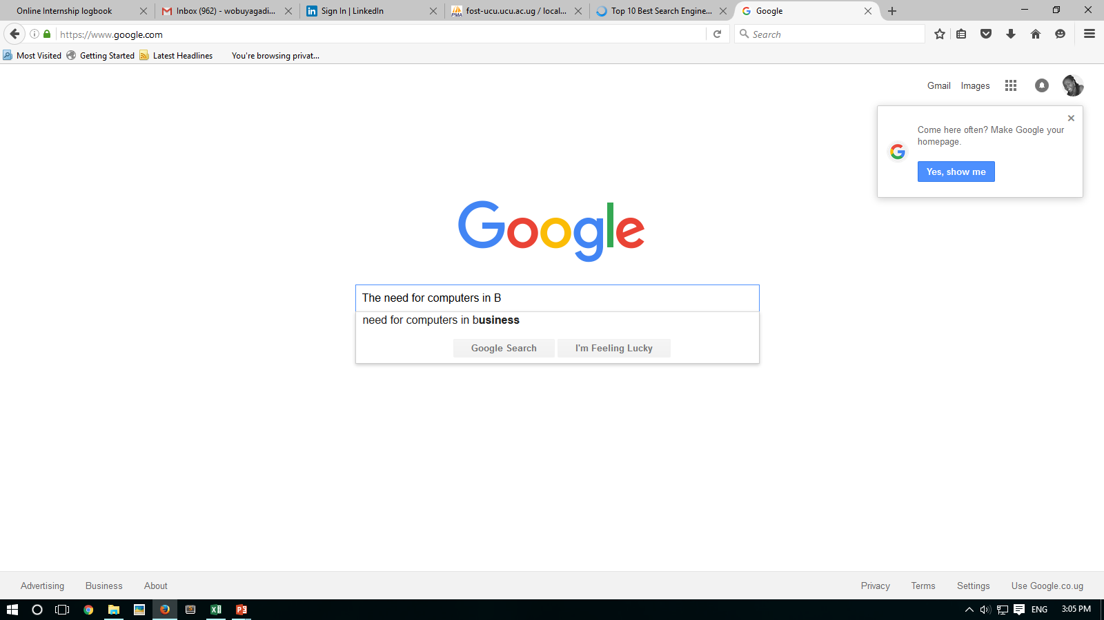
Search for information on the internet

Slide 22
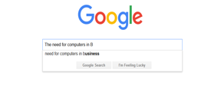


Search Engines
Google chrome
Bing
Yahoo
Ask.com

Slide 23
Advantages of the Internet and the WWW
Introduction to the Internet
Communication – email, chatting
Sharing resources – many can read same information at the same time
Education – online education
Research – access information from any where.
Entertainment – Games
Telecommuting

Slide 24
Advantages of the Internet and the WWW
Introduction to the Internet
E-business, E-Banking
Reduces costs and un-necessary expenditures
Storage of vital information on the remote machines
Easy and quick message transfer
Group work made easy
Used in military to locate enemy

Slide 25
Dis-vantages of the Internet and the WWW
Introduction to the Internet
Abuse of the internet eg, pornography, illicit dating
Computer Crime eg fraud, denial of service, thefts
Consumes time if not properly used
Virus attacks
Used for destruction of property eg buildings - fighting
Hackers

Slide 26
Communication over the Internet
Introduction to the Internet
There are different ways in which we can communicate over the Internet. Electronic mail is common
You should be in position to send a plain text message and also be able to attach a file to a message before you send it. Know all about replying mail, opening an e-mail with an attachment, forwarding mail and deleting mail.

Slide 27
Electronic Mail Ethics /Netiquette
Introduction to the Internet
Sending an e-mail is similar to writing a letter. When you write a letter to someone whether personal or business, there are some unwritten rules. These unwritten rules are called ethics. Ethics on the Internet is called Netiquette (Internet Etiquette). A few netiquettes are listed below

Slide 28
Electronic Mail Ethics /Netiquette
Introduction to the Internet
Does not use a lot of bold letters. Bold indicates emphasizing the word or statement. Too much use of bold letters is similar to shouting.
Do not leave the subject field blank. If you do, it appears that you have nothing to say.
Avoid using acronyms especially when communicating to people who will not understand what you mean.

Slide 29
Electronic Mail Ethics /Netiquette
Introduction to the Internet
Check your message for spelling mistakes before sending it.
Use humor while writing your mail
While sending a copy to someone, make sure it is necessary before you do so. It may be confusing and embarrassing.
Do not send junk mail. Junk mail is mail that is neither expected nor requested for by the receiver

Slide 30
Electronic Mail Ethics /Netiquette
Introduction to the Internet
No recipient wants to read a long boring message. Keep it short and clear
Before sending mail, make sure it conveys exactly what you want to say.
If you want to present a certain point, break it into small pieces of numbered statements.

Slide 31
LABS
Internet
Emails
UCU Cloud

